Slide 1
Java Enterprise Edition
Giorno 2

Slide 2
Giorno 2
Tecnologie Java EE web profile: Java Servlet, Java Server Pages (JSP), JSF, Expression Language.
Pattern MVC e command pattern.
Esercitazione: creare una web application utilizzando il pattern Model-View-Controller (MVC).
Presentation layer e view engines: i tag personalizzati, JSTL (JSP Standard Tag Library), e altre tecnologie di View templating per la costruzione di web layer HTML5/JS/CSS3 AJAX enabled.
Esercitazione: estendere le funzionalità della web application.

Slide 3
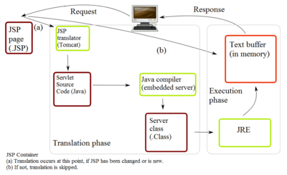
Servlet
import javax.servlet.annotation.WebServlet;
import javax.servlet.http.HttpServlet;
@WebServlet(
name = "MyOwnServlet",
description = "This is my first annotated servlet",
urlPatterns = "/processServlet"
)
public class MyServlet extends HttpServlet {
// implement servlet doPost() and doGet()...
}

Slide 4
JSP
<jsp:useBean> : permette di utilizzare i metodi implementati all’interno di un JavaBean;
<jsp:setProperty> : permette di impostare il valore di un parametro di un metodo di un Bean;
<jsp:getProperty> : permette di acquisire il valore di un parametro di un Bean;
<jsp:param> : permette di dichiarare ed inizializzare dei parametri all’interno della pagina.
<!-- prova.jsp -->
<%@ page language=”java” import=”java.sql.*” %>
<%// dichiarazione di una stringa %> <% ! String stringa=new string(“ciao a tutti”) %> <% // dichiarazione di una funzione che dati due numeri in ingresso // restituisce la loro somma %> <% ! public int somma (int primo, int secondo){ return (primo + secondo); }//somma %>
<html>
<body>
<% out.println("Ciao Mondo!"); %>
</body>
</html>

Slide 5
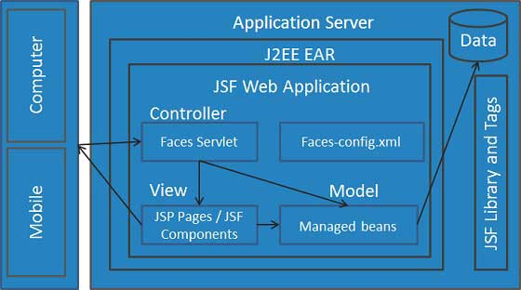
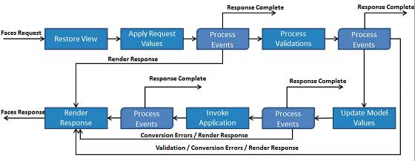
JSF
JSF provides
Core library
A set of base UI components - standard HTML input elements
Extension of the base UI components to create additional UI component libraries or to extend existing components.
Multiple rendering capabilities that enable JSF UI components to render themselves differently depending on the client types

Slide 6
JSF – Configurazione
web.xml
<servlet>
<servlet-name>Faces Servlet</servlet-name>
<servlet-class>javax.faces.webapp.FacesServlet</servlet-class>
<load-on-startup>1</load-on-startup>
</servlet>
<servlet-mapping>
<servlet-name>Faces Servlet</servlet-name>
<url-pattern>/faces/*</url-pattern>
</servlet-mapping>
<servlet-mapping>
<servlet-name>Faces Servlet</servlet-name>
<url-pattern>*.jsf</url-pattern>
</servlet-mapping>
<servlet-mapping>
<servlet-name>Faces Servlet</servlet-name>
<url-pattern>*.faces</url-pattern>
</servlet-mapping>
<servlet-mapping>
<servlet-name>Faces Servlet</servlet-name>
<url-pattern>*.xhtml</url-pattern>
</servlet-mapping>
pom.xml
<dependencies>
<dependency>
<groupId>com.sun.faces</groupId>
<artifactId>jsf-api</artifactId>
<version>2.1.7</version>
</dependency>
<dependency>
<groupId>com.sun.faces</groupId>
<artifactId>jsf-impl</artifactId>
<version>2.1.7</version>
</dependency>
</dependencies>

Slide 7
JSF - MVC
Model
@ManagedBean(name = "helloWorld", eager = true)
@RequestScoped
public class HelloWorld {
@ManagedProperty(value="#{message}")
private Message message;
...
}
View
<!DOCTYPE html PUBLIC "-//W3C//DTD XHTML 1.0 Transitional//EN"
"http://www.w3.org/TR/xhtml1/DTD/xhtml1-transitional.dtd">
<html xmlns=http://www.w3.org/1999/xhtml
xmlns:h=http://java.sun.com/jsf/html
xmlns:ui="http://java.sun.com/jsf/facelets" >
<head>
<title>JSF Tutorial!</title>
</head>
<body>
#{helloWorld.message}
</body>
</html>

